Slide 1
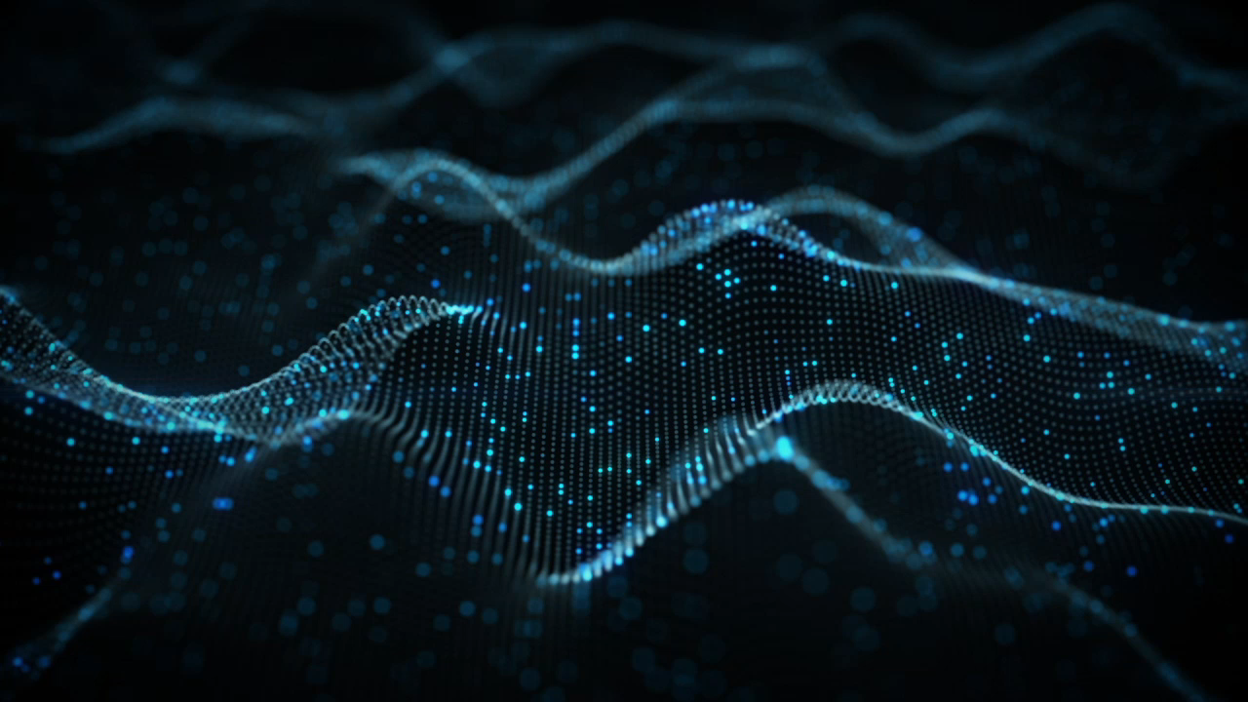
Cosmic Ray Counting Using Cosmic Box
Liceo Cavour Roma
A.S 2021-2022
CREF- Extreme Energy Events

Slide 2
Topics
What are cosmic rays
EEE experiment
How cosmic rays are revealed
The Cosmic Box .Cosmic Box Delivery
The measures: notice about Liceo Cavour
The measures at the Liceo Cavour
Data tables and graphs of measurements at the Cavour high school
Comment
The measures: notice about Basilica San Clemente
The measures at San Clementete
Data tables and graphs of the measures at San Clemente
Comment
Conclusions

Slide 3
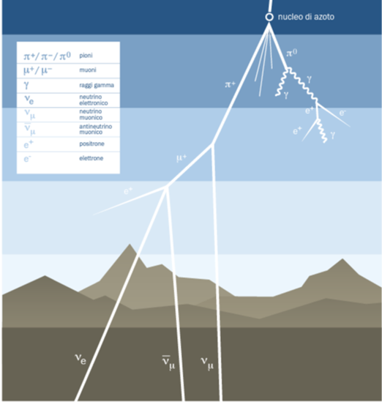
The Cosmic Ray
Cosmic rays, also called Astro particles, are subatomic particles of medium or high energy that impact the Earth every day.
They are the product of the interaction of primary cosmic rays with the Earth's atmosphere.
The impact produces a swarm of particles (the secondary rays ) of different types that can be detected with special instruments that take advantage of the properties of cosmic rays to interact with matter, for example, by causing the ionization of a gas, as in the detector chambers of the Extreme Energy Events (EEE) project, or by exciting the production of photons, as in the scintillation chambers of the Cosmic Box.
One of the fundamental properties of cosmic rays is the variation of their flux with altitude, a feature that has led in the past to the identification of the same cosmic rays as extraterrestrial radiation.

Slide 4



EEE (Extreme Energy Events) Project
The EEE project (Extreme Energy Events) is a research project of the:
CREF (Centro Ricerche Enrico Fermi) in collaboration with:
CERN (Conseil Européen pour la Recherche Nucléaire - European Nuclear Research Council),
INFN (Istituto di Fisica Nucleare - National Institute for
Nuclear Physics)
MIUR (Ministero dell'Istruzione, Universita' e Ricerca - Ministry of Education, Universities and Research)
This project is carried out in collaboration with the schools, which house a detector for the identification and study of cosmic rays.
The detector is built by the students at CERN and is managed and maintained by them with the help of the teachers in the school.
The data collected by the detector is then sent in real time to the CNAF (Centro Nazionale Analisi Fotogrammi - National Center for Image Analysis) in Bologna and to the INFN computer center.
Students can use the data for practice purposes, always under the control of the Enrico Fermi Center, which organizes regular running meetings.
The schools that don't have the detector nevertheless perform data analyzes

Slide 5
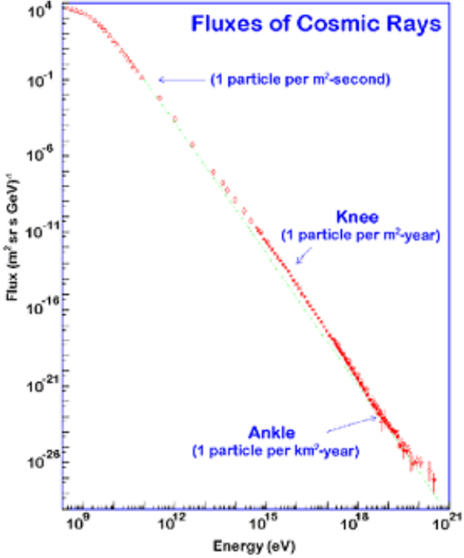
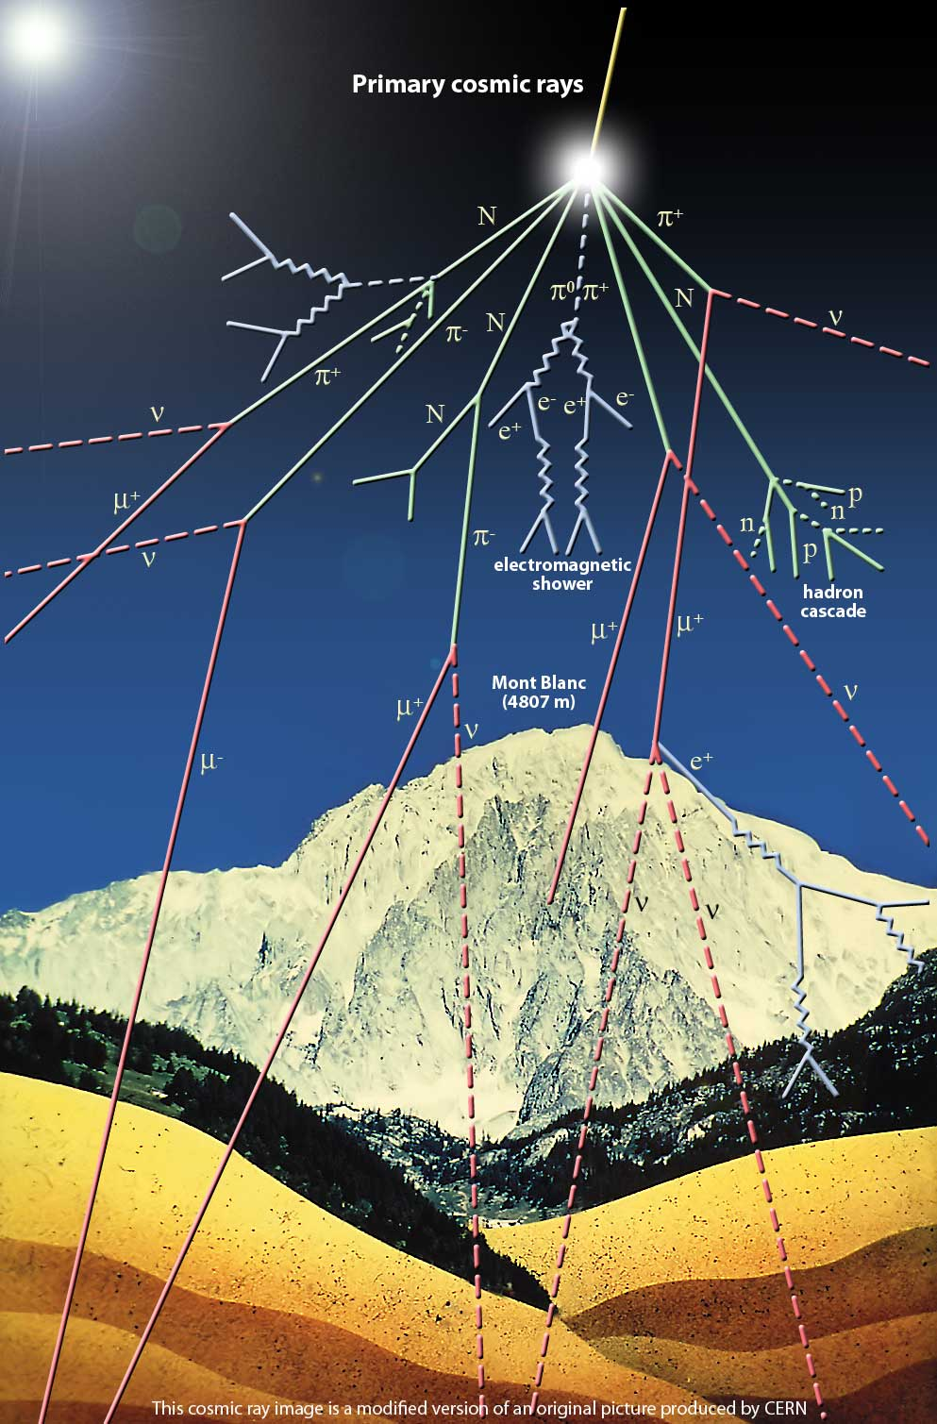
How cosmic rays are revealed
Cosmic rays are the product of the interaction of primary cosmic radiation with the Earth’s atmosphere.
The impact produces a swarm of particles of different species that can be detected through the use of special tools that exploit the properties of cosmic radiation to interact with matter, for example by causing the ionization of a gas, as in the chambers of the EEE detectors (Extreme Energy Events) or by stimulating the production of photons as in the scintillation chambers of the Cosmic Box.
When the energy increases and the flow of Cosmic Rays becomes very low, you have to have large surface experiments.
From the characteristics of the "shower" of particles can be derived the energy and direction of the primary cosmic ray.
.

Slide 6
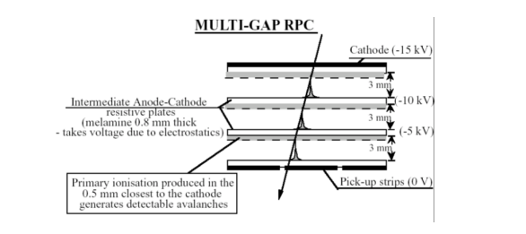
The EEE detector
The EEE detector is a Multigap Resistive Plate Chamber (MRPC) that can measure, among other things, the time-of-flight of subnuclear particles.
It consist of three superimposed chamber containing gas that is ionized when a charged particle passes through.
The energy and direction of the primary cosmic rays are determined by counting and reconstructing the direction of the muon component.
Correlation of event measured by different telescopes is done later using GPS technology, which can identify simultaneous events.
In recent years, for the school that don’t have a telescope, smaller and manageable telescopes, for detecting cosmic rays have been developed, that is the Cosmic Box.

Slide 7
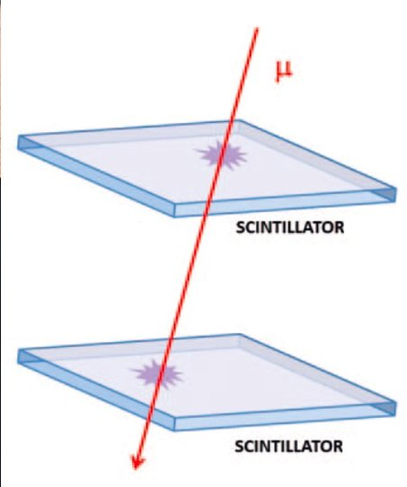
The Cosmic Box
The Cosmic Box is a device consisting of two parallel plates (15cmx15cmx1cm) of scintillator material, overlapping and spaced about 30 cm apart.
The scintillators of the Cosmic Box produce meaningful signals when they are used together, i.e., when only the signals that are
passing through both chambers are recorded.
When a charged particle passes through the scintillator material, some of its energy is converted into scintillation (light signal). The photons thus produced are directed by suitable design measures to a photosensor SiPM (Silicon Photo Multilayer) and converted into an electrical signal.

Slide 8
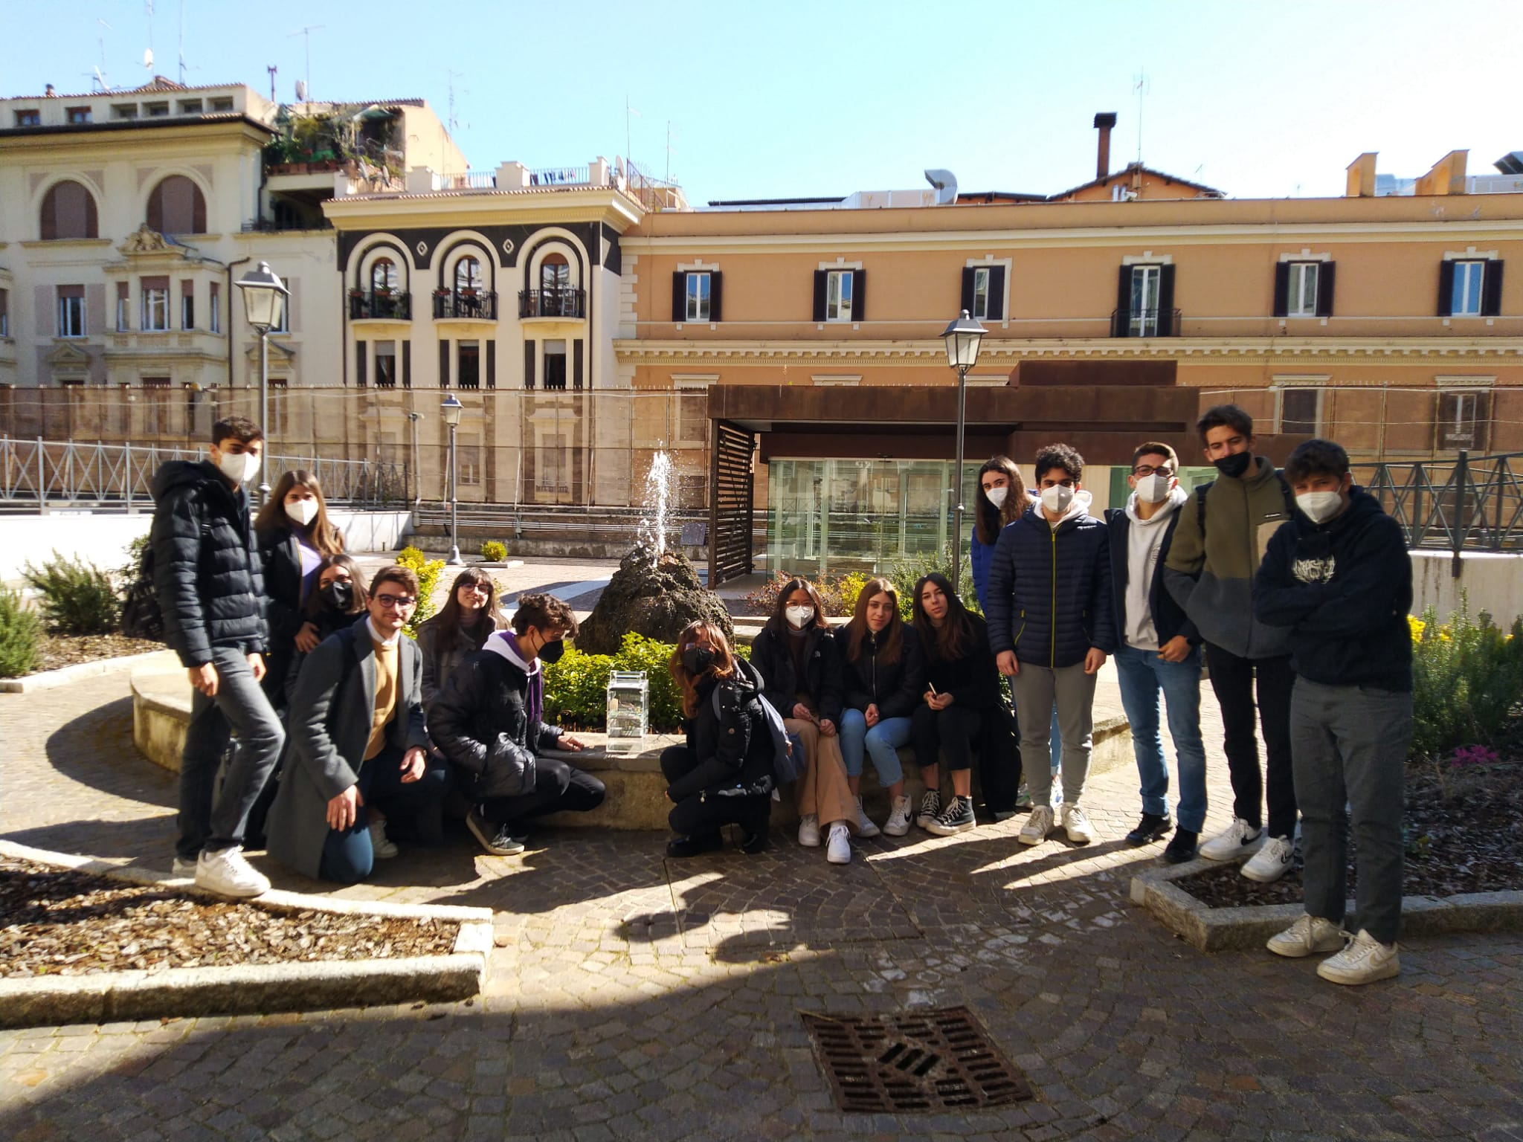
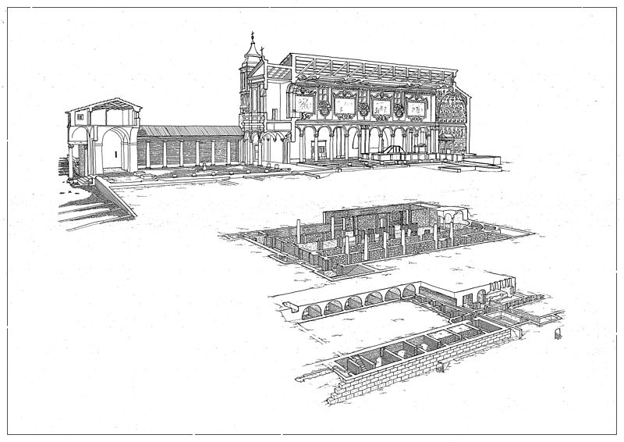
Victory of the Cosmic Box
The Cosmic Box was won, in 2019, by the High School C. Cavour by participating in a contest before the pandemic, it was presented to the students at the end of the visit to the Fermi Center.
One of the characteristics of the winning project of the competition was that it included an action campaign for the Basilica of San Clemente in Rome. The church consists of three different levels where you can count the cosmic rays in a spectacular historical and artistic context

Slide 9
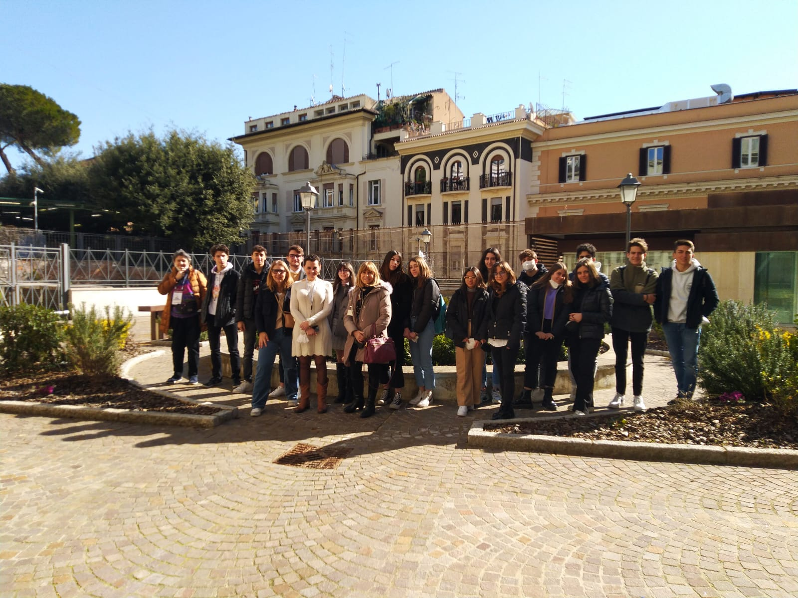
Delivery of the Cosmic Box
On March 2, 2022, we visited the historic building in Via Panisperna to hand over the Cosmic Box, a useful instrument for detecting cosmic rays that the school had won after participating in a competition before the Covid-19 pandemic.
When we arrived at the building, we were welcomed by Dr Silvia Pisano and the historian of science Dr Miriam Focaccia, who guided us through the museum and all the symbolic places of Enrico Fermi's discoveries.
At the end of the visit, we received the Cosmic Box that we used for the measurements.
The cosmic box was used to carry out two measurement campaigns, one at the Liceo Cavour and one at the Basilica of San Clemente

Slide 10
C.Cavour High School
Liceo Scientifico Camillo Cavour is a scientific high school located in the centre of Rome, in the Colosseum area. It was the first scientific high school in Rome.
Our school takes the name of Camillo Benso Conte di Cavour: protagonist of Risorgimento and supporter of liberal ideas, civil and economic progress.
The area occupied by the buildings of the Liceo Cavour corresponds to a very important and little-known part of ancient Rome, whose known remains are only some sections of paving of ancient streets, which often coincide with modern paths, and a few buildings that were in medieval churches such as San Pietro in Vincoli.
The building in which the high school is located consists of two buildings; in particular, building B extends over four floors, and it was in this building that the measurements were made

Slide 11
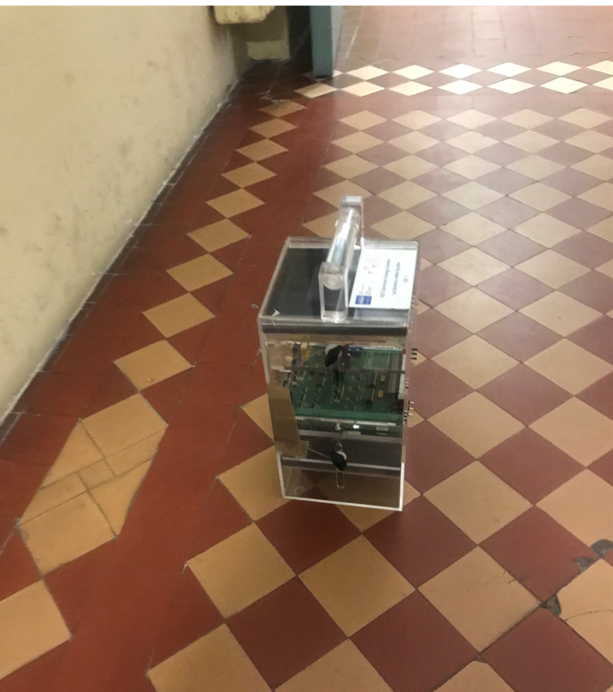
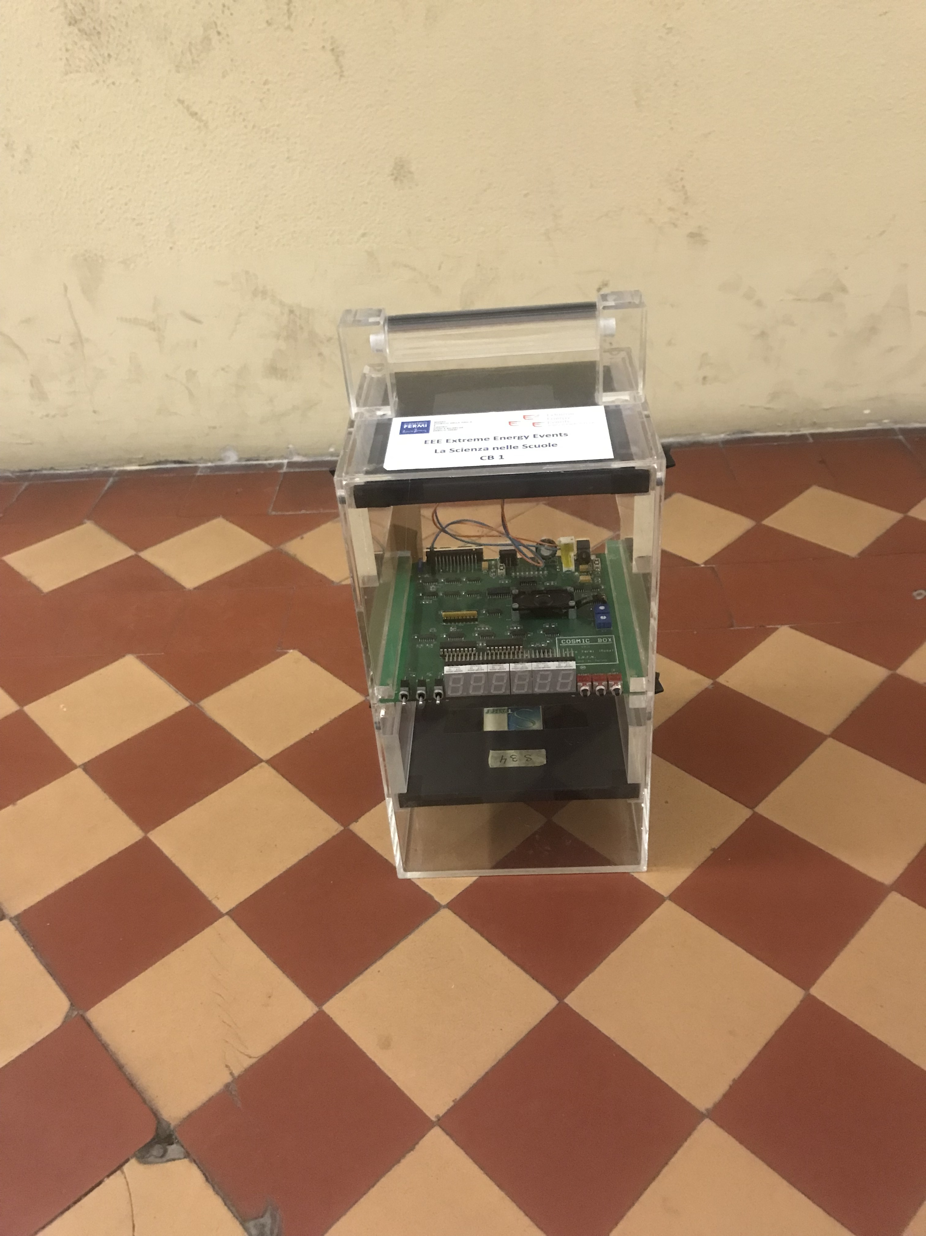
The measures at Liceum Cavour
The measuring device was positioned at the different floors of the building, always at a distance of about (1.0 ± 0.1) m from the back wall of the corridor in front of the elevator shaft.
Times were measured using the stopwatch of a commercially available smartphone with an error of about 2s.
Pressure (763 mmHg) and temperature (19°C) were measured using a dedicated cell phone app.
The acquisition time of the counts was set to 60s for each of the 10 measurements in all the series of measurements.
The number of counts for each measurement is shown in the nest table ; the mean was calculated for each of the series; the error on the mean was calculated using the standard deviation.

Slide 12
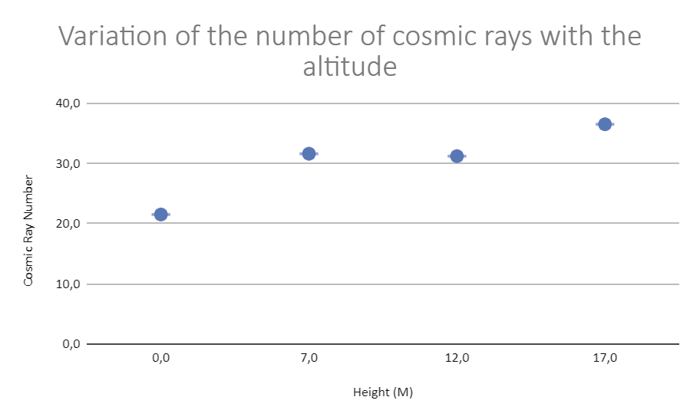
Tables and graphs of the measures at the Liceum Cavour
 |  | Height with respect to the ground floor (m) ±0,1
 |  | 0 | 7 | 12 | 17
 | s±2 | Two-count error for each measurement
n | Time | Ground Floor | First Floor | Second Floor | Roof
1 | 60 | 20 | 38 | 37 | 41
2 | 60 | 19 | 36 | 40 | 36
3 | 60 | 23 | 31 | 21 | 40
4 | 60 | 25 | 31 | 30 | 35
5 | 60 | 27 | 32 | 26 | 29
6 | 60 | 16 | 36 | 26 | 45
7 | 60 | 25 | 32 | 30 | 30
8 | 60 | 20 | 40 | 32 | 33
9 | 60 | 16 | 17 | 38 | 42
10 | 60 | 24 | 23 | 32 | 34
 | Height with respect to the ground floor (m) ±1
 | 0 | 7 | 12 | 17
Average | 22 | 32 | 31 | 37
St. Dev | 4 | 7 | 6 | 5

Slide 13
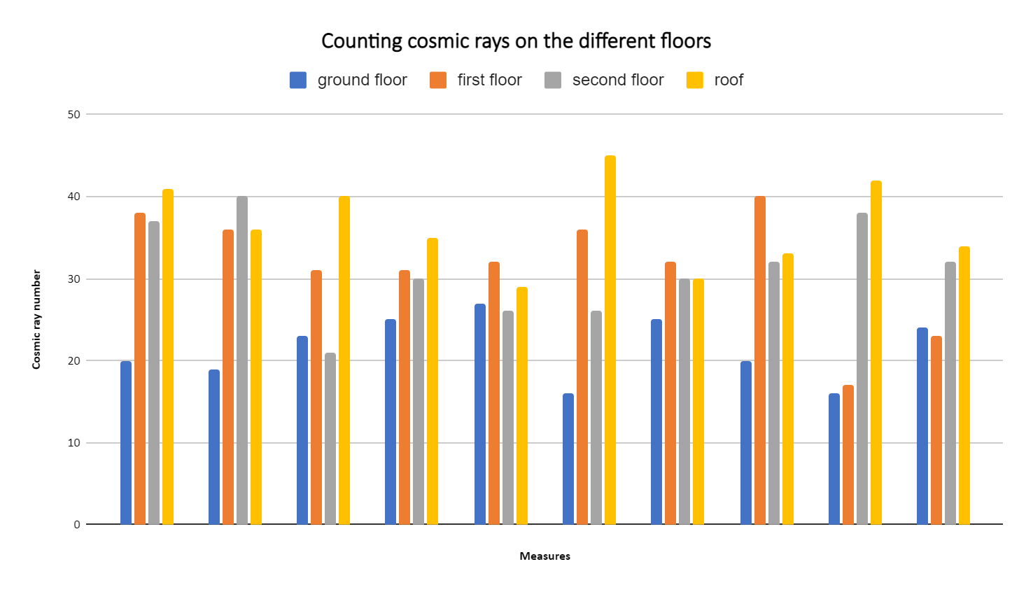

Slide 14
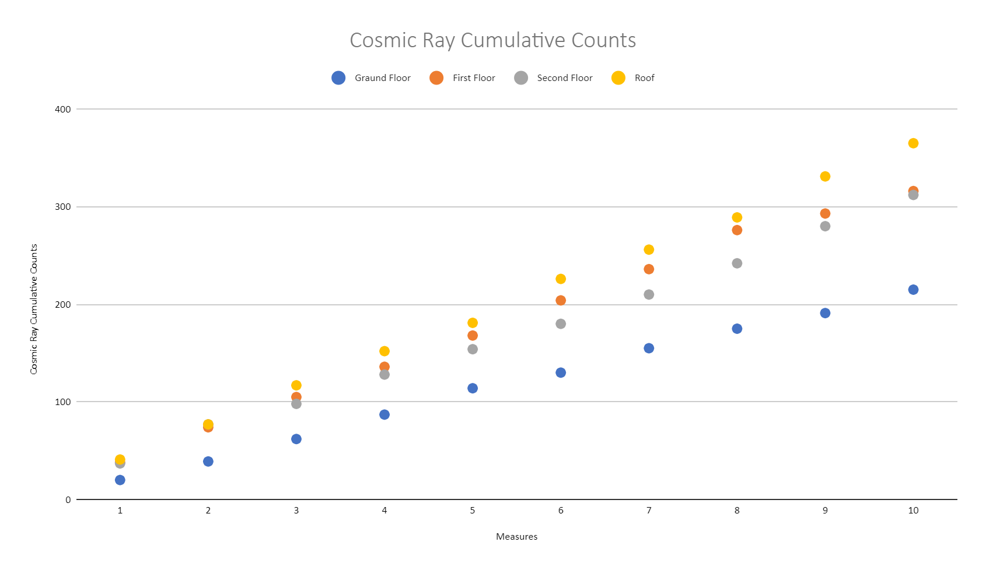

Slide 15
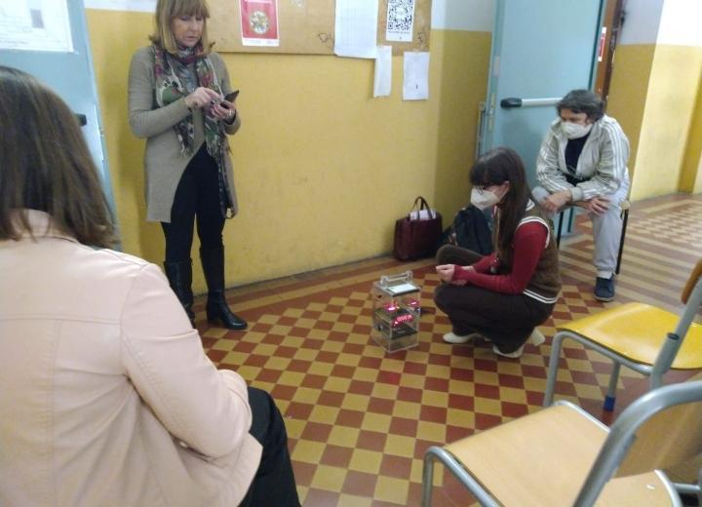
Comment on the results of the measurements at High School C.Cavour
The experimental results obtained confirm the increase in the number of cosmic rays with altitude. More significant measures could be carried out using higher quota differences. A more accurate analysis of the phenomenon should examine the behavior of secondary radiation through the solid thicknesses of the floors of the different floors of the building.

Slide 16
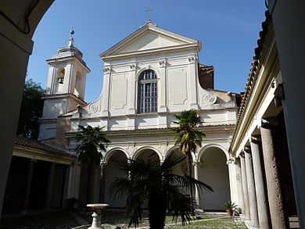
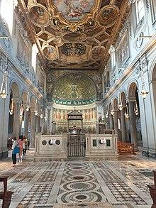
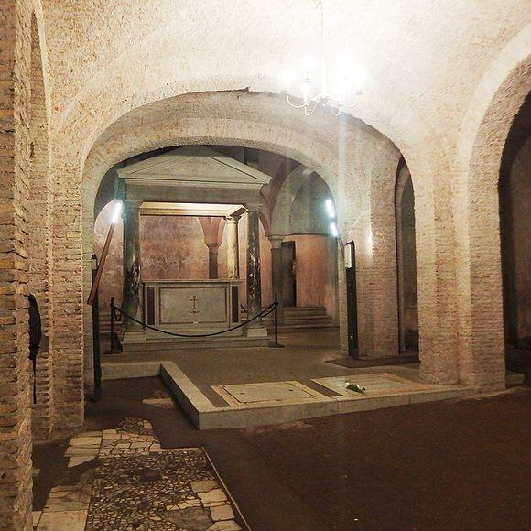
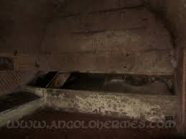
Basilica of S.Clemente*
The Basilica of S.Clemente is a church located in the center of Rome. Its main feature is that under the surface building there are two other levels of ancient roman buildings,, discovered in 1857. It was named after Pope Clemente I.
The first level, the one currently on surface, is a medieval church, built between 1099 and 1120. The intern consist of 3 naves and many chapels, all covered by a coffered ceiling. the floor is entirely covered by a geometrical mosaic.
The second level is what is left of a previous church, built during the III century. This building had been severely damaged by the Normans in 1084, during the Sack of Rome, so it was partially demolished for the construction of the upper level.
The third underground level consist of two buildings,dated around the I century; the bigger one is thought to have been a deposit, while the smaller one was probably a house, even if it’s better known as the Mithraeum building, since it has been shown that it served as a place of worship for the Mithraic religion. both the buldings are made out of tuff blocks.
*Thanks to the Irish Dominican Fathers for allowing the scientific activity in the Basilica and to Dr. Di Gregorio for promoting the contact between the Rectors of the Basilica and the Liceo Cavour.*

Slide 17
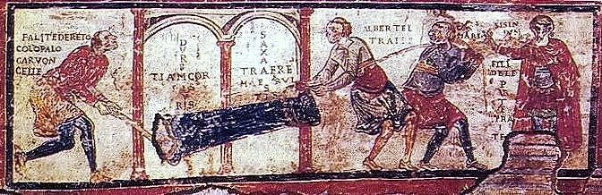
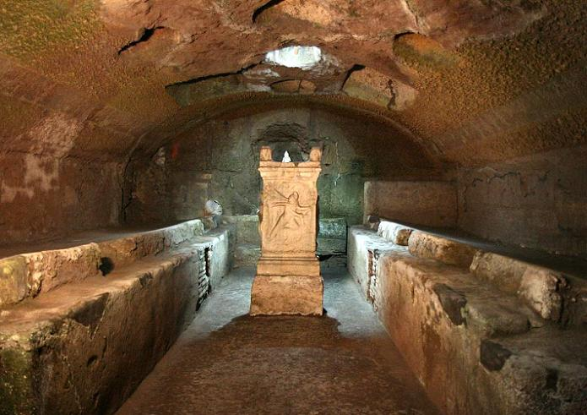
Historical relevance of S. Clemente
This fresco shows one of the oldest known writings in vulgar latin.
The yard of the III century roman domus was transformed into a Mitreo, a temple dedicated to the cult of the God Mitra.

Slide 18
Tables and Data Acquired at S. Clemente
Average | 56 | 23 | 28
St. Dev | 7 | 16 | 11
 | Church level | First Underground Level | Second Underground Level
n | 3 | 2 | 1
1 | 54 | 37 | 4
2 | 67 | 22 | 34
3 | 47 | 34 | 18
4 | 64 | 33 | 17
5 | 60 | 18 | 32
6 | 58 | 51 | 30
7 | 55 | 15 | 32
8 | 59 | 3 | 40
9 | 51 | 9 | 36
10 | 43 | 5 | 38
Cosmic Ray Cumulative Count
n | Church level | Church level Cumulative Counts | First Underground Level | First Underground Level Cumulative Counts | Second Underground Level | Second Underground Level Cumulative Counts
1 | 54 | 54 | 37 | 37 | 4 | 4
2 | 67 | 121 | 22 | 59 | 34 | 38
3 | 47 | 168 | 34 | 93 | 18 | 56
4 | 64 | 232 | 33 | 126 | 17 | 73
5 | 60 | 292 | 18 | 144 | 32 | 105
6 | 58 | 350 | 51 | 195 | 30 | 135
7 | 55 | 405 | 15 | 210 | 32 | 167
8 | 59 | 464 | 3 | 213 | 40 | 207
9 | 51 | 515 | 9 | 222 | 36 | 243
10 | 43 | 558 | 5 | 227 | 38 | 281
The acquisition time of the counts was set to (120±2) s for each of the 10 measurements in each series.
The number of counts for each measurement is shown in table ; for each measurement the error is ±2 counts; the mean was calculated for each of the series; the error on the mean was calculated using the standard deviation.
The exact heights of the levels of the Basilica are not known and the levels have been identified as 1,2,3 in ascending order of depth.

Slide 19
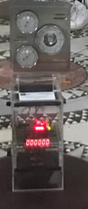
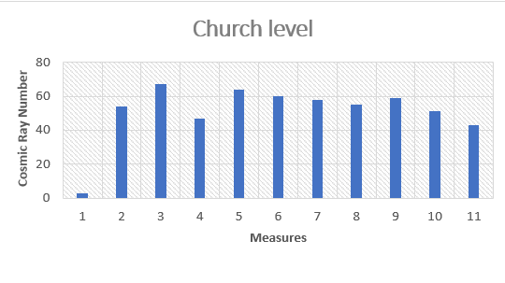
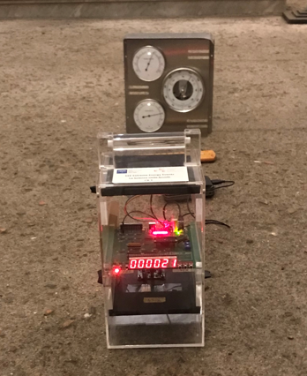
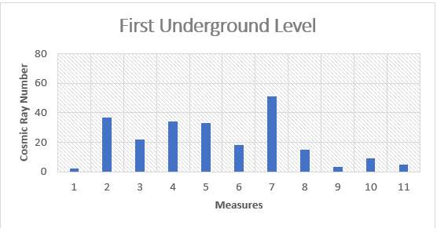
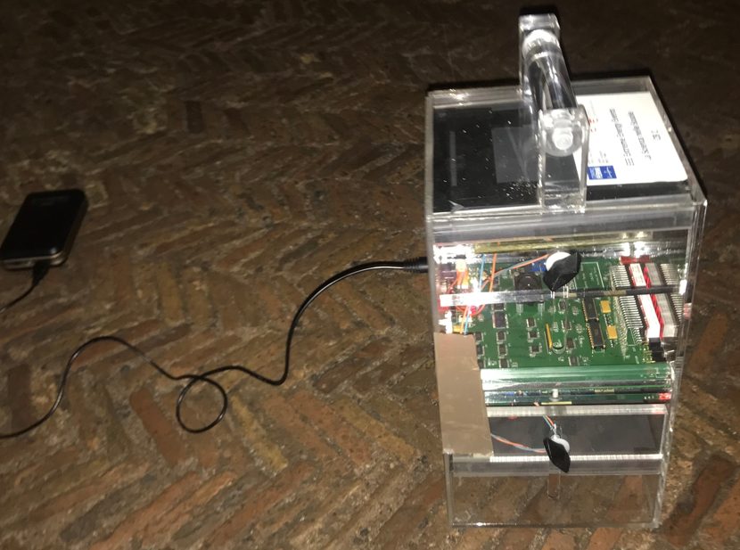
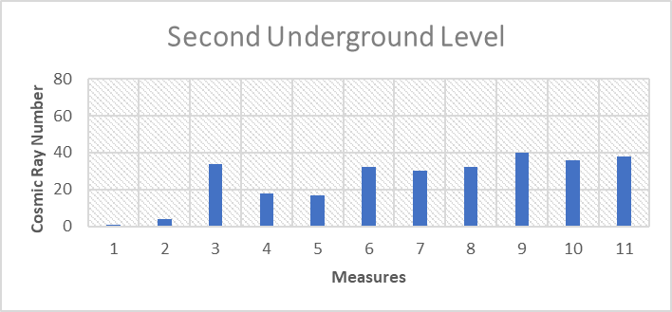
Histograms relating to the counts of cosmic rays at the different levels of the Basilica

Slide 20
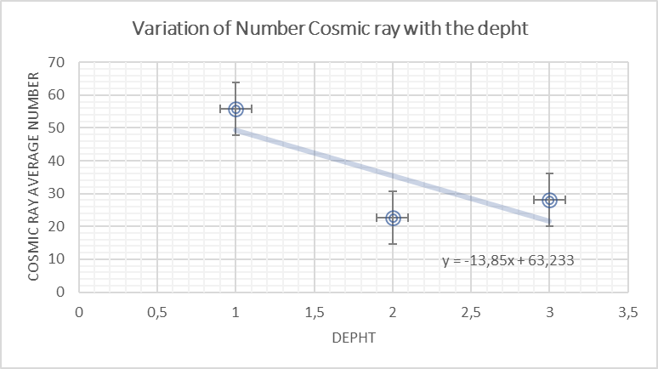
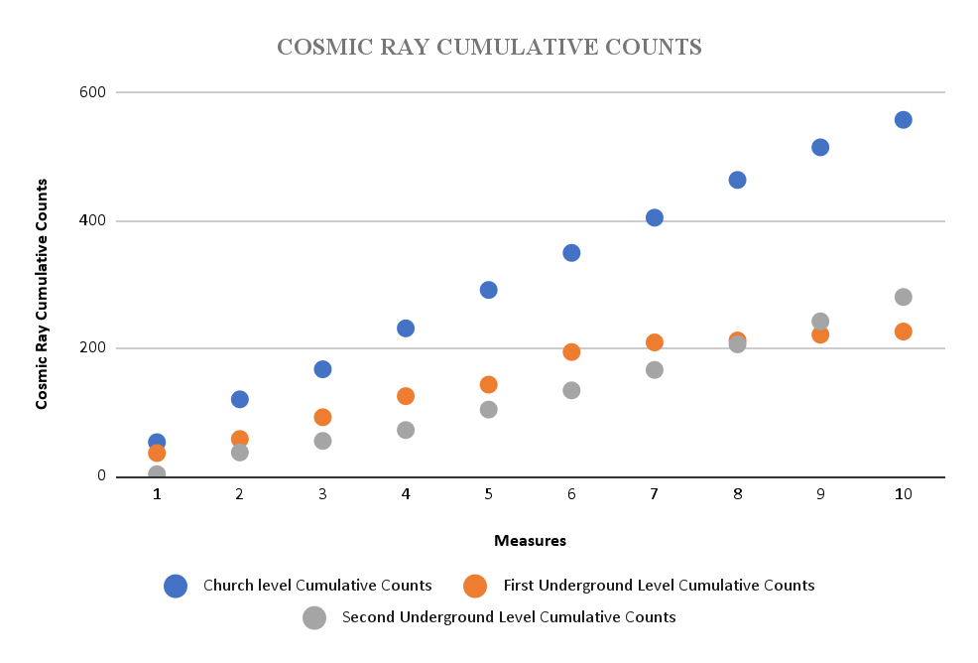
Trend of cosmic rays with depth

Slide 21
Comment on the results of the measurements at S. Clemente
The analysis of the data and diagrams obtained during the measurements inside the basilica show some peculiarities, because it was expected that the number of cosmic rays would decrease towards the lower levels of the basilica.
On the first subterranean level, there is a clear decrease and variability in the counts, but this is not observed on the lowest level, where the number of cosmic rays seems to be higher than expected.
To verify that no signals unrelated to cosmic rays were recorded at the lowest level, measurements were made at a later time than that of the initial measurements using only the bottom chamber of the Cosmic Box, which, however, recorded only an insignificant number of signals.
Measurements were also made outside the basilica, which, as expected, recorded a higher number of counts.
The variability in the number of counts could be due to the different materials that make up the floors of the basilica, which has undergone several restorations over time. On the first floor of the basilica the ceiling is coffered, on the first basement a restoration was carried out with the classical bricks, while on the lower floor the Roman tuff wall is still preserved.

Slide 22
Conclusions
The two campaigns of measurements carried out with the Cosmic Box confirmed, despite some anomalies, the behavior of cosmic rays whose number tends to increase with height.
Further investigations should also consider the behavior of cosmic rays when they pass through materials of different types.

Slide 23
Thanks for your attention!

